Slide 1



CAFE MANAGEMENT SYSTEM

Slide 2

TEAM PROJECT: PRINCE KUMAR – 2210992090 PRERNA SHARMA -2210992086 PRAGTI GUPTA - 2210992056

Slide 3

1. Introduction
Objective
It is a desktop application which deals with "Cafe Management System". The system has two parts first for the "Admin" and the other for “employee”.
The admin side allows the customer to "Place Order“ ,"Add Item", "Update Items" & "Remove Items" and the employee can only "Place order" & "Generate Bill" of purchase for the customer.
Domain
In this project admin can add, update or delete the details of the items and employee can take the order of the customer & generate the bill.
Scope
The division of work like placing customer order and generating bill will be performed by the employee and adding items and their price will be performed by the admin.

Slide 4
2. ABSTRACT
"Café Management System" is a desktop application. This system is developed to automate day to day activity of a food cafe. Food café is a kind of business that serves people all over world. This system is developers service facility to cafe owners. This café management system can be used by employees in a café to handle the customers, their orders and can help them easily place orders. Main objective to build this system is to provide management service to the café owners. They can keep track of the records, instead of taking orders in paper they can take the order in the Café Management System where admin can easily add, update or delete the items from the menu at ease. This system also provide the security to café owner business as there is no way any employee can misuse the system because they won’t have permissions to update the prices of item or delete any transactions.

Slide 5

3. MODULES
PLACE ORDER:
CHOOSE CATEGORY
SEARCH BY NAME
SELECT QUANTITY
ADD TO CART
REMOVE PRODUCT
GENERATE BILL

Slide 6
4.RESOURCE REQUIREMENT
Human Resource
All members of team come from International University, so we have a good basic knowledge about software process and skill in programming as well as team-work.
Hardware and software Resources
Cafeteria Management System is created by using PYTHON, with functions and small database, so we just need an average sever

Slide 7
Non-Functional C/ External Requirement Requirement Description
Item Illegal The website must use legal items. The system will be acceptable to users and the general public.

Slide 8
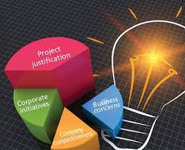
Justification for project and Methodology !

Slide 9
WORK PLAN 1.The customer must open "The cafe club" Webpage. 2.The customer must register his/her id and credentials to the page. 3.Order portal of the coffee club will be opened. 4.Customer should fill in the required order in the portals of the food items. 5.Customer should click on the cost button. 6. The Receipt of the food items ordered will appear with their prices and the tax added. 7.If you want to change your order then kindly click on the "RESET" button given below. 8.On clicking the button "PRICES' interface will show the list of food items with their prices as of Quantity 1. 9.For more information contact kindly visit! The Coffee Club" website on facebook: The coffee club -02 Instagram : The coffee club-02 Thank you!!! for your order please review on our website. HOPE TO SEE YOU AGAIN!!

Slide 10
Achievement and Outcomes
The Project is identified by the merits of the system offered to the user. The achievements of this project are as follows:->
It's a Desktop-based enabled project.
This project offers user to enter the data through simple and interactive forms. This is very helpful for the client to enter the desired information through so much simplicity.
The user is mainly more concerned about the validity of the data, where he is entering. There are checks on every stages of any new creation, data entry or updating so that the user cannot enter invalid data which can create problems at later date.
Sometimes the user finds in the later stages of using project that he needs to update some of the information that he entered earlier. There are options for him by which he can update the records. Moreover, there is restriction for his that he cannot change the primary data field this keeps the validity of the data to longer extent.

Slide 11
PURPOSE & SCOPE Purpose The main purpose preparing these documents is to give a general insight into the analysis and requirements of the existing system or situation and for determining the operating characteristics of the system. The proposed software will solve all the problem they are facing now. This software is designed such way that it will generate the bill automatically every order in time. So there not much worries. This being a Desktop based application is very easy to access. Data and Records are managed in centralized database. Data is secure and easy to retrieve, store, and analysis, so chances of miscalculations and occurrence of error are very less.

Slide 12

Scope This system will help to manage and run the café shop systematically. In this management system, we will provide an app that can be used by cafe's employee to take order. So that owner of shop can evaluates the whole system. This will ultimately lead to hire less waiters and create and opportunity to appoint more chefs and better shop to serve coffee faster. Employee can take payment which will managed into the software.

Slide 13
Motivation >
The Coffee Club is guaranteed to become the daily necessity for all. A place with good ambience where people can extempt from their daily stress and cherish delicious food. Our club offers home style delicious food. We have many branches in many cities. We have a romantic ambience which attracts youth. Our club has spectacular interior designs with stupendous taste. We have attached our menu which contains food at attractive prices. We have also analyzed our opportunities and threats from the external environment

Slide 14

reference
https://sourcecodehero.com/cafe-management-system-project-in-python-with-source-code/#h-cafe-management-system-project-in-python-project-output
Research papers
Lab mentor
Dr. Anu Priya
Ms. Nabanita Roy

Slide 15
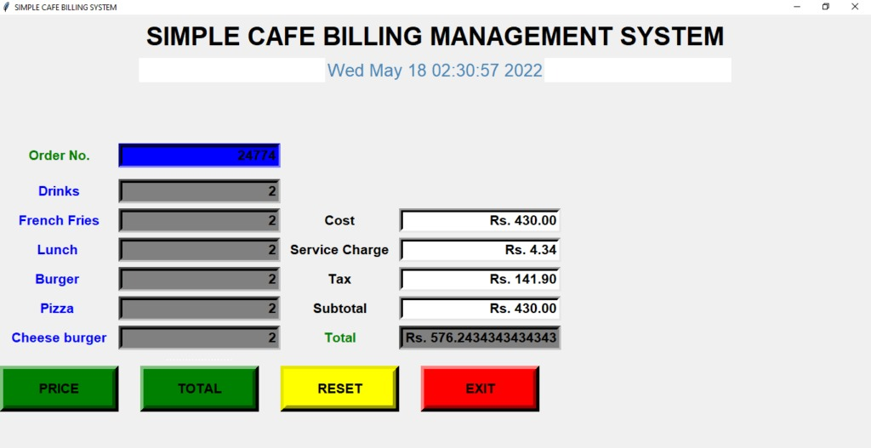
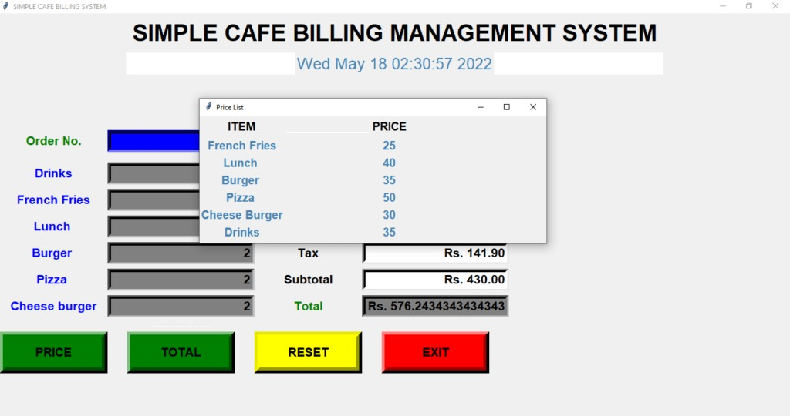
BILLING MANAGEMENT

Slide 16

CAFÉ MANAGEMENT SYSTEM
Thanks for watching!

